Slide 1
IOT SECURITY
Presented By:
Student Name:S.Anantha satheesh kumar
College Name:The Kavery Engineering College
Department:B.E-Computer Science and Engineering

Slide 2
INTRODUCTION
IoT (Internet of Things) refers to the network of interconnected devices embedded with sensors, software, and other technologies to exchange data and interact with the environment. While IoT brings convenience and efficiency, it also introduces significant security challenges due to the large number of devices, diverse communication protocols, and varying levels of security standards.

Slide 3
OUT LINES
Problem Statement (Should not include solution)
Proposed System/Solution
System Development Approach (Technology Used)
Algorithm & Deployment
Result (Output Image)
Conclusion
Future Scope
References

Slide 4
PROBLEM STATEMENT
The problem statement for IoT security revolves around addressing vulnerabilities within interconnected devices, networks, and data streams. This includes safeguarding against unauthorized access, data breaches, malware attacks, and ensuring the integrity, confidentiality, and availability of IoT systems and data.
Additionally, managing the complexity of diverse devices, protocols, and standards while balancing usability and security is a key challenge. Moreover, ensuring continuous monitoring, updating, and patching of IoT devices throughout their lifecycle is crucial to mitigate evolving threats and risks.

Slide 5
PROPOSED SYSTEM & SOLUTION
A proposed solution for IoT security involves implementing a multi-layered approach that includes:
Device-level Security:
Ensuring IoT devices are equipped with robust security features such as encryption, authentication mechanisms, secure boot, and tamper detection to prevent unauthorized access and tampering.
Network Security:
Implementing secure communication protocols such as TLS/SSL, VPNs, and firewalls to protect data transmission between IoT devices and backend systems, as well as segmenting IoT networks from other critical infrastructure.
Data Security:
Employing encryption techniques to protect sensitive data both in transit and at rest, and implementing access controls to regulate data access based on user roles and permissions.

Slide 6
Authentication and Access Control:
Implementing strong authentication methods such as biometrics, multi-factor authentication, and role-based access control to ensure only authorized users and devices can access IoT systems and data.
Security Monitoring and Incident Response:
Deploying intrusion detection systems, security analytics, and real-time monitoring tools to detect and respond to security threats promptly. This includes establishing incident response plans and procedures to mitigate the impact of security breaches.
Regular Updates and Patch Management:
Ensuring IoT devices and software are regularly updated with the latest security patches and firmware updates to address known vulnerabilities and mitigate potential security risks.

Slide 7
System Development Approach
An effective IoT security system approach involves a comprehensive framework that encompasses several key components:
Risk Assessment:
Conducting a thorough risk assessment to identify potential vulnerabilities, threats, and risks associated with the IoT environment, including devices, networks, data, and applications.
Security by Design:
Integrating security principles and best practices into every stage of the IoT system development lifecycle, from design and development to deployment and maintenance.
Device Management:
Implementing robust device management practices to ensure the secure provisioning, configuration, monitoring, and maintenance of IoT devices throughout their lifecycle. This includes managing firmware updates, access controls, and authentication mechanisms.

Slide 8
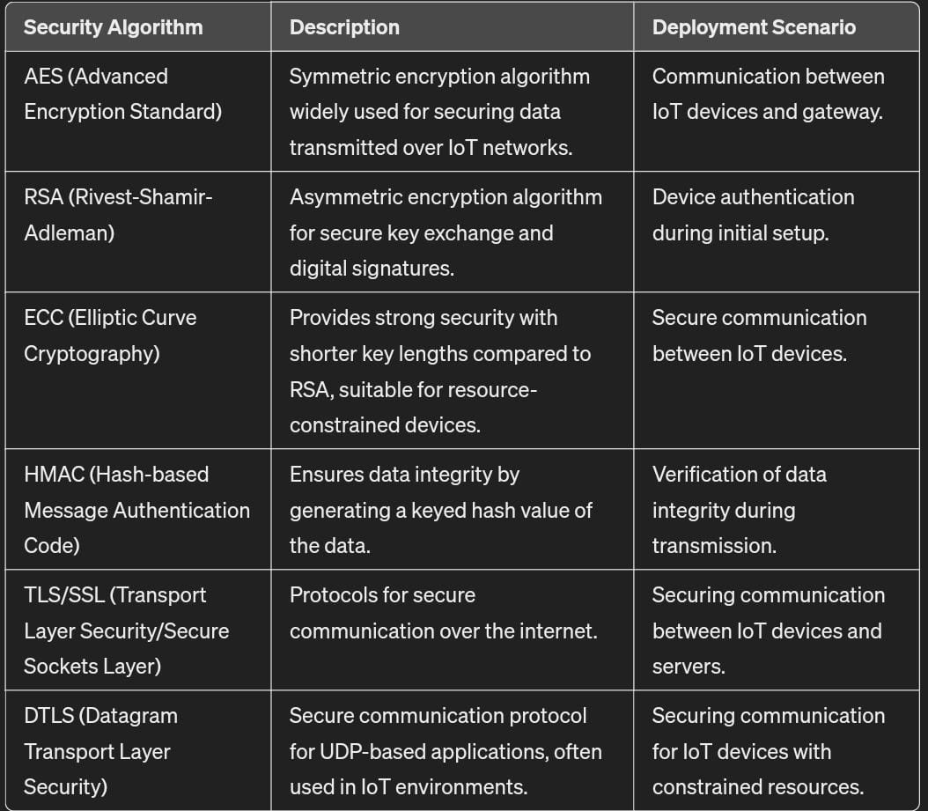
Algorithm & Deployment

Slide 9
import hashlib
def generate_hash(data):
return hashlib.sha256(data.encode()).hexdigest()
class IoTDevice:
def _init_(self, device_id, secret_key):
self.device_id = device_id
self.secret_key = secret_key
def authenticate(self, received_hash):
expected_hash = generate_hash(self.secret_key + self.device_id)
return received_hash == expected_hash
# Example usage:
device_id = "device123"
secret_key = "mysecretkey"
received_hash = "f0a5e2d10ee5e35ec81e1c36cf395edfa8b8ac1c1907688c7d63c205b021cafa"
device = IoTDevice(device_id, secret_key)
if device.authenticate(received_hash):
print("Authentication successful!")
else:
print("Authentication failed!")

Slide 10


RESULT(OUTPUT)

Slide 11
CONCLUSION
In conclusion, ensuring robust IoT security is imperative to safeguard against potential threats and vulnerabilities. It demands a multi-layered approach encompassing device authentication, data encryption, network segmentation, regular updates, and user education.

Slide 12
FUTURE SCOPE
Black chain integration
Artificial intelligent and machine learning
Edge computing
Security automation
Zero trust architecture
Private preserving technology
Regulatory compliant

Slide 13
REFERENCE
Internet of Things (IoT) Security: Current Status, Challenges, and Prospects" by Shancang Li, Lina Yang, and Qiben Yan. (DOI: 10.1109/JIOT.2015.2457383)
"Security and Privacy Challenges in the Internet of Things (IoT) Environment" by Pradeep Kumar Singh, et al. (DOI: 10.1145/3131542.3131574)
"A Survey of Security and Privacy Issues in IoT for Smart Cities" by Danda B. Rawat, et al. (DOI: 10.1109/ACCESS.2017.2686678)
"IoT Security: Review, Blockchain Solutions, and Open Challenges" by Adnan Akhunzada, et al. (DOI: 10.1109/ACCESS.2019.2890219)
"Security and Privacy in Internet of Things (IoT): Models, Threats, and Solutions" by M. Tariq Banday and Abid Haleem. (DOI: 10.1016/j.future.2018.09.011)
"A Comprehensive Review on Security and Privacy Issues of Internet of Things (IoT)" by Iman Dehzangi, et al. (DOI: 10.3390/s18072258)

Slide 14
THANK YOU...

